Slide 1
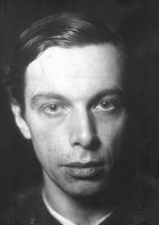
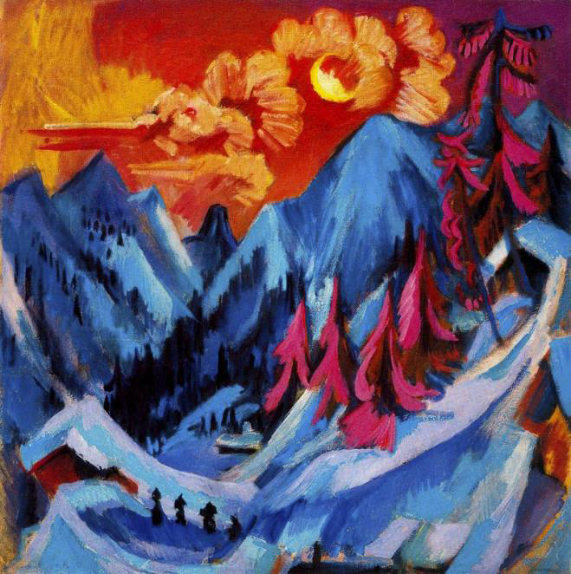
Ernst Ludwig Kirchner
K to 2nd grade
and penguins

Slide 2
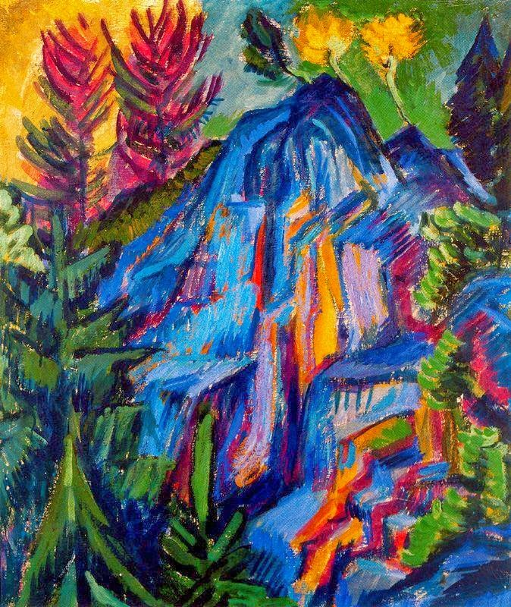
Ernst Ludwig Kirchner
Painter and printmaker
German Expressionism
Painted how he felt rather than
what he saw
Used bold colors that did not look like the things he painted
He used bold WARM and COOL colors

Slide 3
What are warm and cool colors?

Slide 4
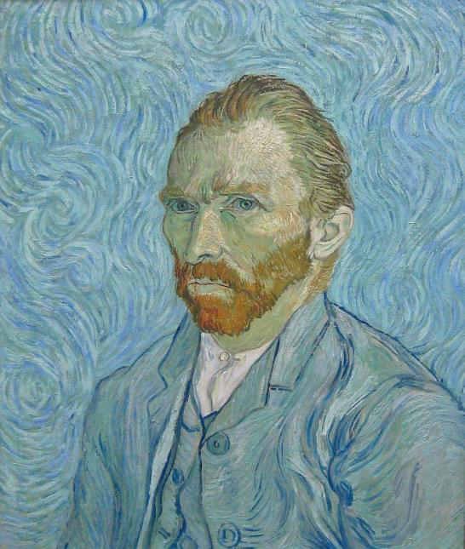
Many artists played around with either warm or cool colors to convey emotions.
Are these warm or cool?

Slide 5
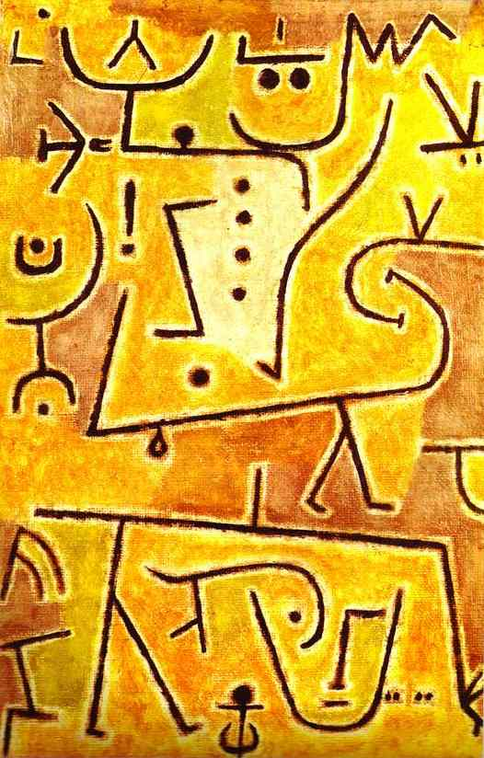
That was Vincent Van Gogh’s self-portrait in cool colors.

Slide 6
That was Paul Klee’s Red Waistcoat in warm colors.

Slide 7
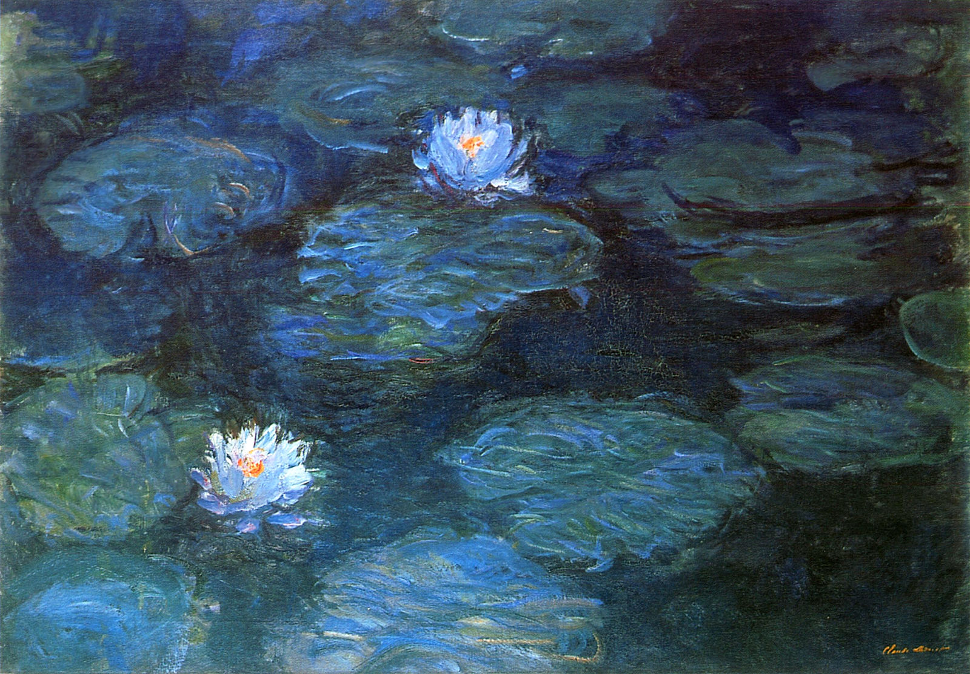
That was Mark Rothko’s Orange, Red, Orange in warm colors.

Slide 8
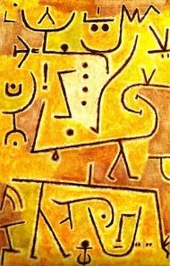
And the last one was Claude Monet’s water lilies in cool colors.
How do the colors make you feel?
Which make you happy? Sad?
Which one would you like to use today?

Slide 9
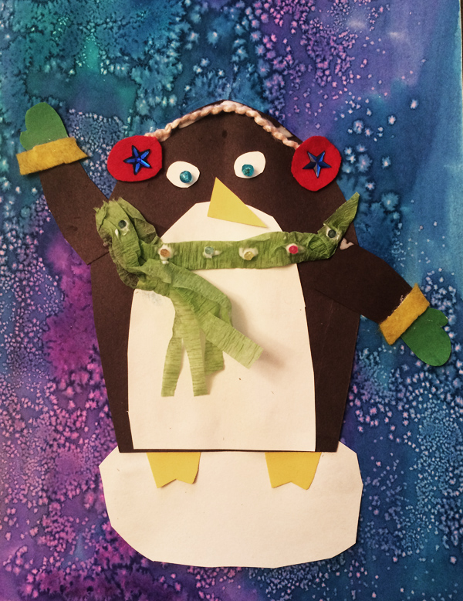
Let’s make some ART!

Slide 10
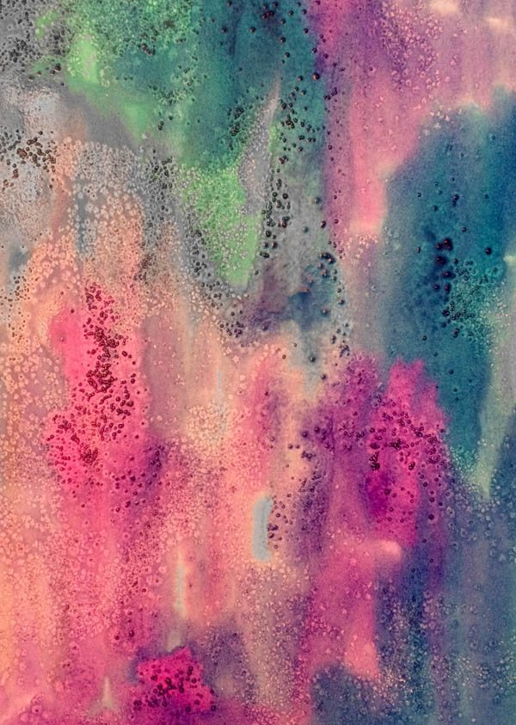
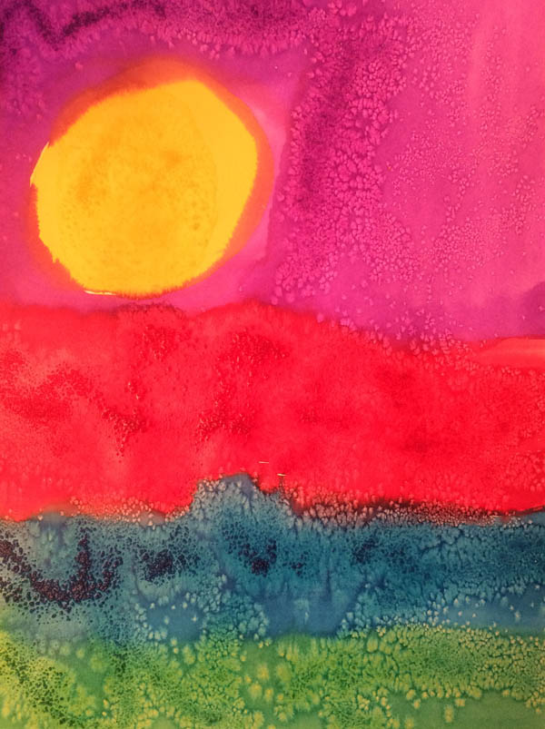
First think about your colors
Are you going to use only warm or cool colors? Do you want to use both?
Remember: do not mix warm and cool colors together.
You would get brown. We want the colors to stay bold and bright!

Slide 11
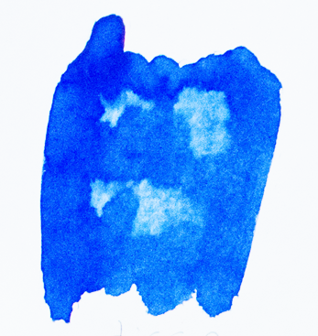
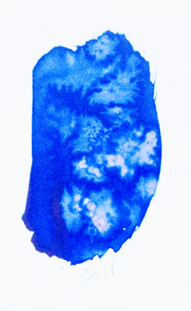
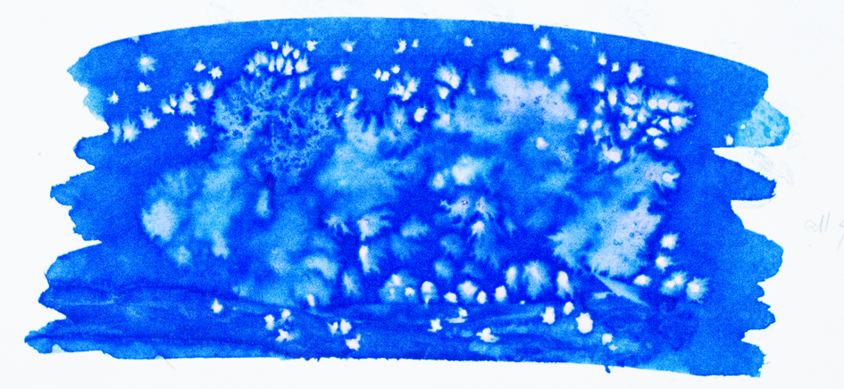
Let’s paint your background
We use watercolors.
While the paint is still wet, we add texture.
HOW?
If you combine it together,
you get a fun visual texture!
Pick up some paint
with a crumbled paper towel.
Sprinkle salt on the paint.
Leave it there until it dries.
It will ‘drink’ the paint and it will look like this.
LET it DRY.

Slide 12
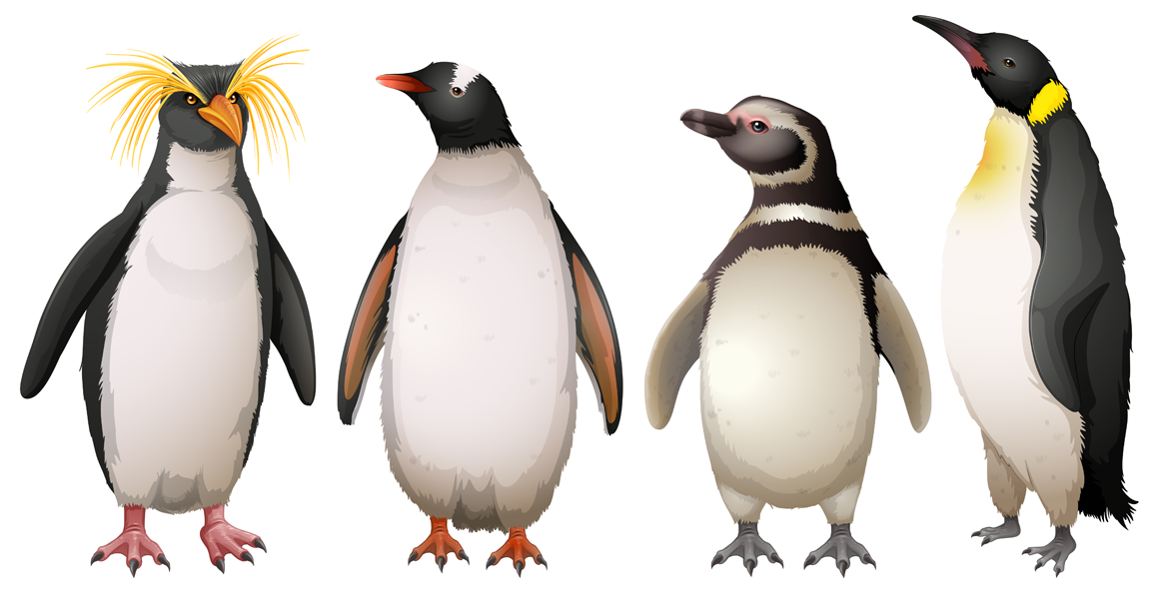
Let’s start working on our penguin now.
DO YOU KNOW?
If the penguins can ever meet Polar bears?
How come they are not cold?
Why do they keep warm in temperatures up to 25.8°F?

Slide 13
Let’s start working on our penguin now.
If the penguins can ever meet Polar bears?
NO: Polar bears live on the North Pole and penguins live in the South.
How come they are not cold?
Their feathers and fat layer keep their warm.
Why do they keep warm in temperatures up to 25.8°F?
Because that is the temperature the seawater freezes.

Slide 14
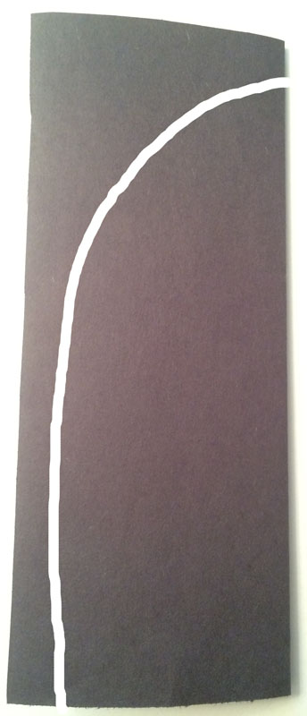
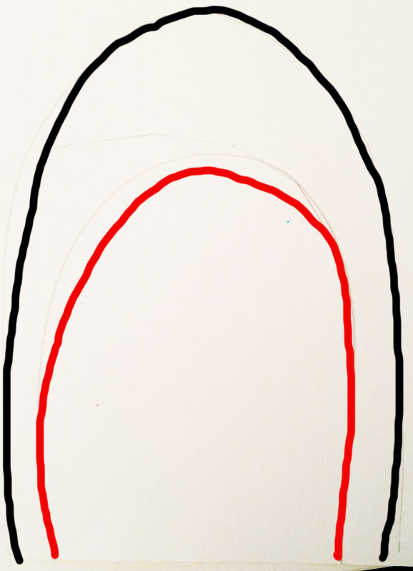
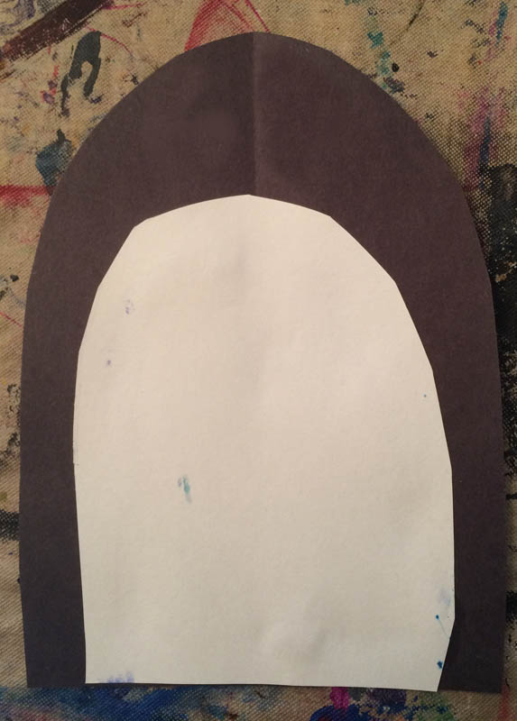
Let’s make your penguin!
Fold the black paper in half. Cut out this shape.
Open it: that’s your penguin!
Trace the penguin onto a white paper.
Draw a smaller shape inside: that will be the penguin’s belly.
Cut out the inside (red) line.
Glue it together like this.

Slide 15
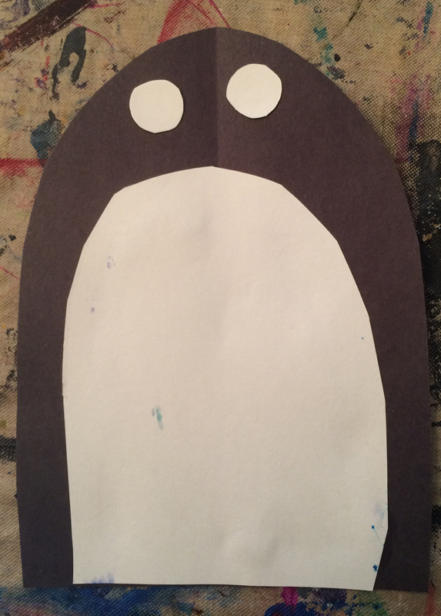
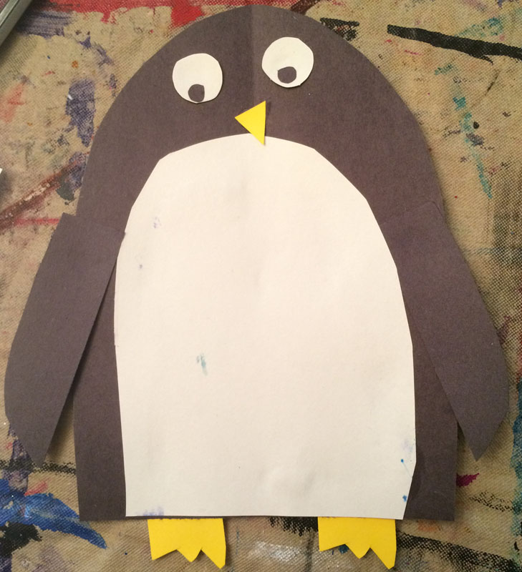
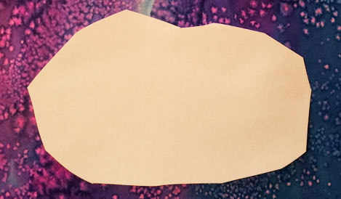
Add details to your penguin
Cut out two circles for eyes.
Cut out wings, beak and legs.
Glue it all together.
Now cut out some ice out of
white paper so that your penguin
has a place to sit on.
Glue it onto your watercolor paper.

Slide 16
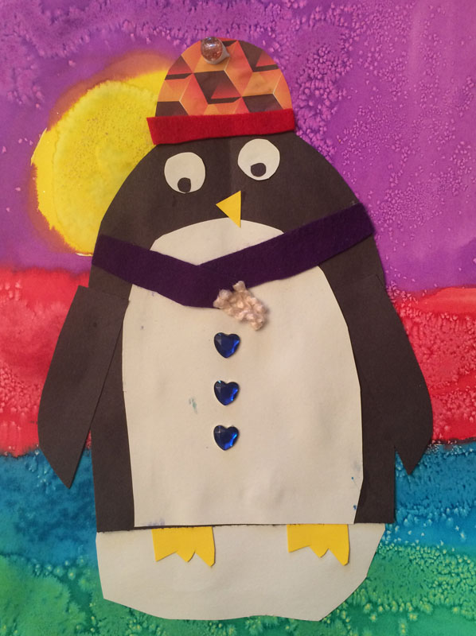
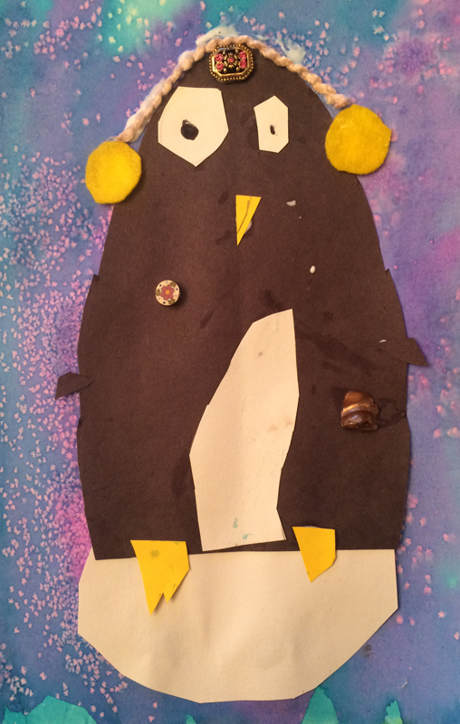
Decorate your penguin to help him stay warm!
Use colored papers, yarn, buttons, gems, tissue paper… to decorate your penguins.
Help them stay warm with gloves, mittens, sweaters, scarves or hats!

